Slide 1
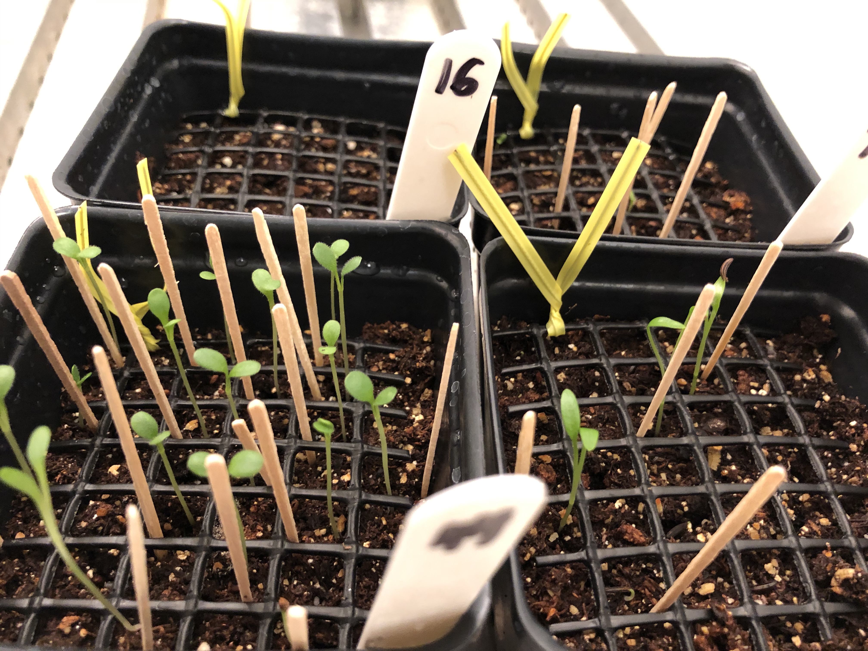
DAC 2021
Dan Buonaiuto
January 21, 2021

Slide 2
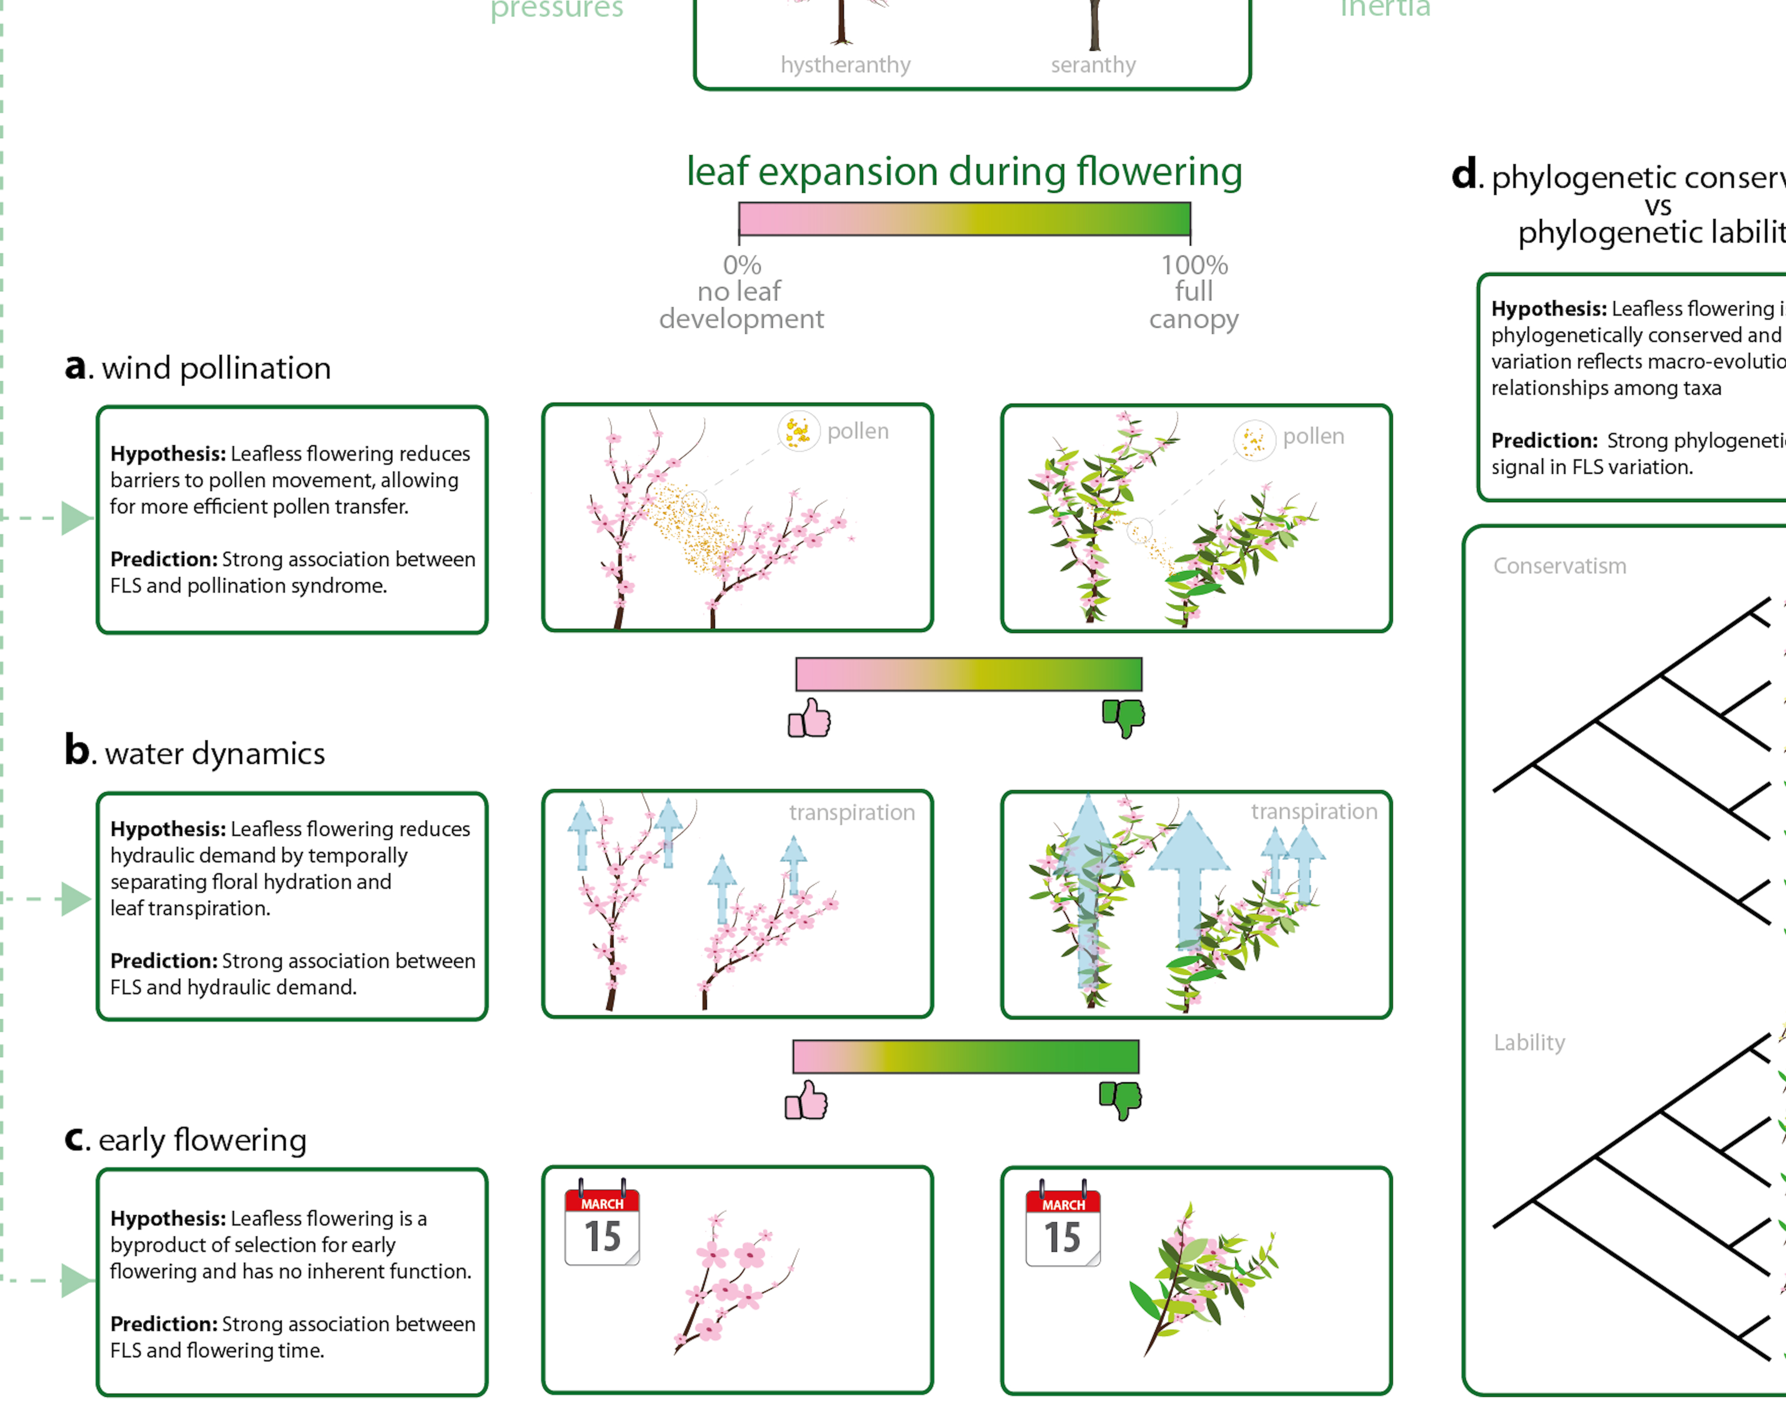
Chapter 1: Reconciling competing hypotheses regarding flower-leaf sequences in temperate forests for fundamental and global change biology New Phytologist, 2020

Slide 3
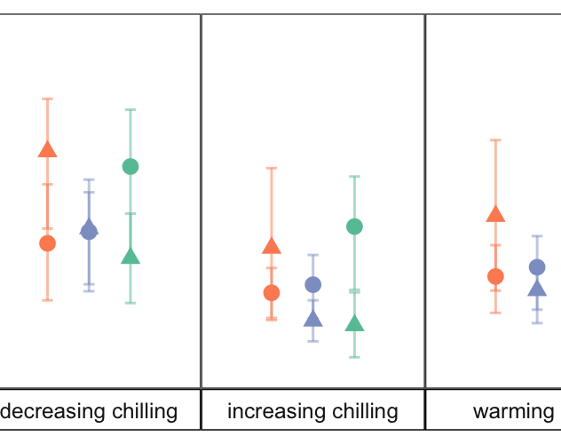
Chapter 2: Differences in flower and leaf bud environmental responses drive shifts in spring phenological sequences of temperate woody plants Submitted to Journal of Ecology, 2020

Slide 4

Chapter 1
FLS variation
Chapter 2
Environmental variation and species interactions
FLS variation
Seasonal priority effects on plant competition
Cue differences and SPE’s
Cue differences and SPE’s
Seasonal priority effects on plant competition
Drivers of FLS variation in insect pollinated taxa

Slide 5
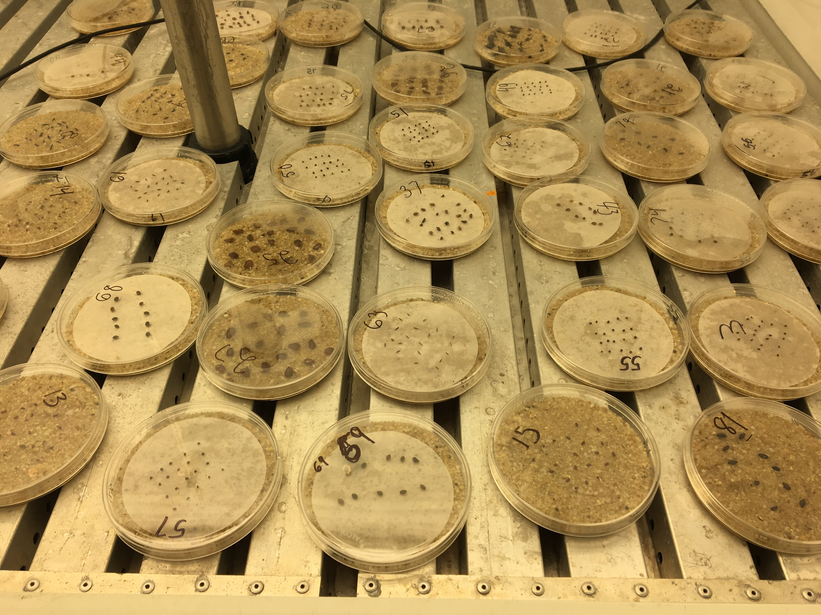
How different are germination to varying stratification and incubation temperatures?
Are they enough to allow for seasonal priority effects?
Recent reviews give us an estimate of > 5-10 days.
Responses modeled with an Accelerated Failure Time Model

Slide 6
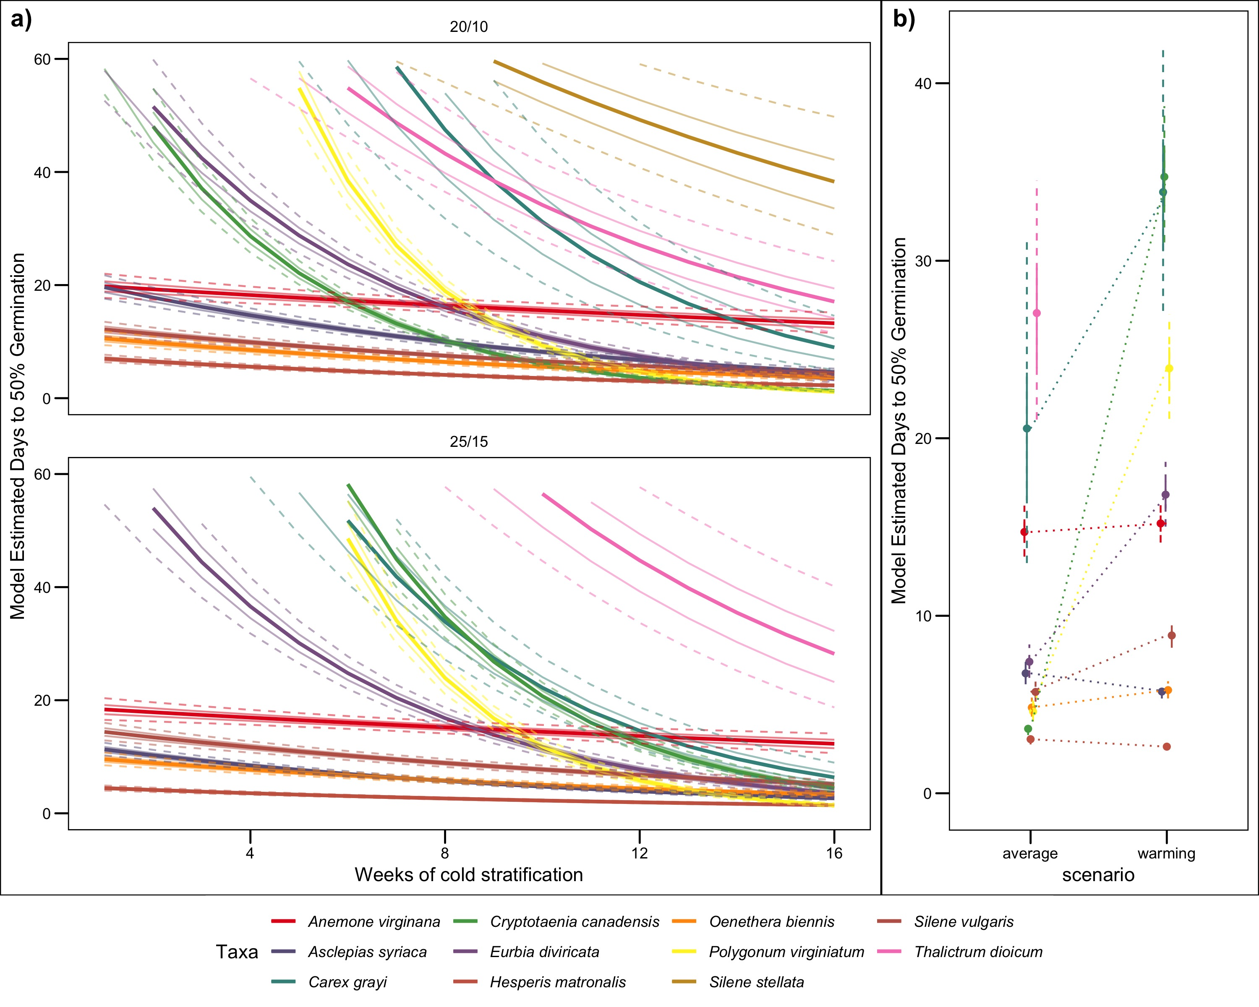

Slide 7
Chapter 1
FLS variation
Chapter 2
Environmental variation and species interactions
FLS variation
Seasonal priority effects on plant competition
Cue differences and SPE’s
Seasonal priority effects on plant competition
Drivers of FLS variation in insect pollinated taxa

Slide 8
Chapter 1
FLS variation
Chapter 2
Environmental variation and species interactions
FLS variation
Drivers of FLS variation in insect pollinated taxa
Cue differences and SPE’s
Seasonal priority effects on plant competition
Drivers of FLS variation in insect pollinated taxa

Slide 9
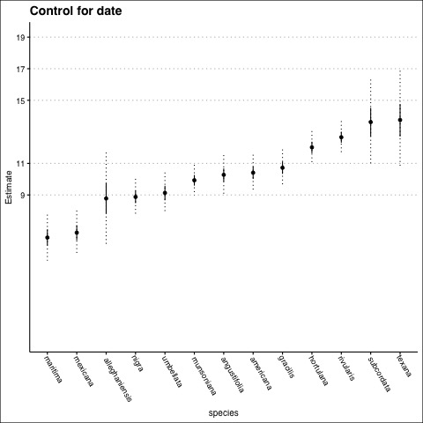
Scored 2,305 herbarium specimens for floral and foliate BBCH stages in Prunus sect. Prunocerasus
Next steps: test relationships with functional traits for major FLS hypothesis using joint modeling approach
PDSI
Low temperatures
Petal length
Fruit size and phenology
Notes:
Why pruncerasus ? All considered flower before flower before/with and flower with– different sources score differently

Slide 10
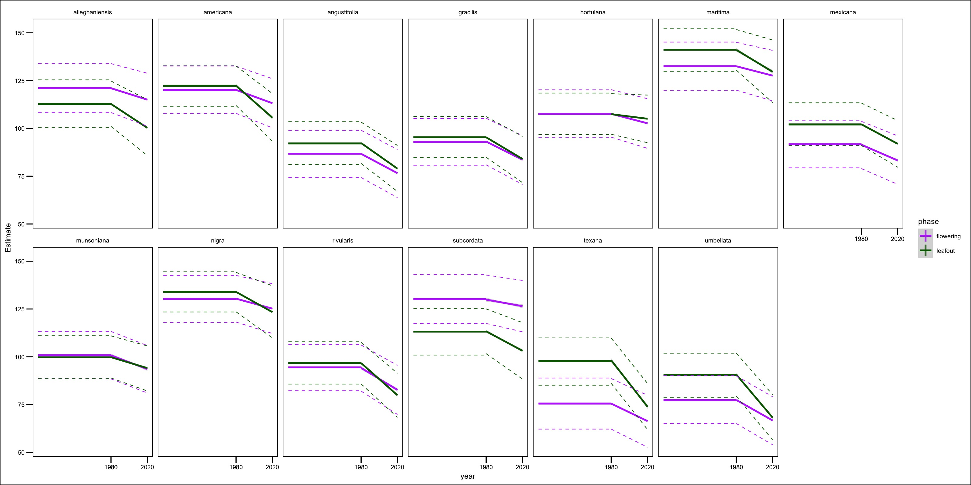
Climate Change impacts of FLSs of Prunoceracus

